Slide 1
User Interface Design Tools
Lecturer: Ngo Huy Bien
Software Engineering Department
Faculty of Information Technology
VNUHCM - University of Science
Ho Chi Minh City, Vietnam
nhbien@fit.hcmus.edu.vn

Slide 2

Objectives

Slide 3

Contents

Slide 4

References

Slide 5
1. Create Mockups
https://v0.app/
Create mockups for the following database schema.
No links are working.
The New Material, Receive Lot, New Test, and other links must be working.

Slide 6
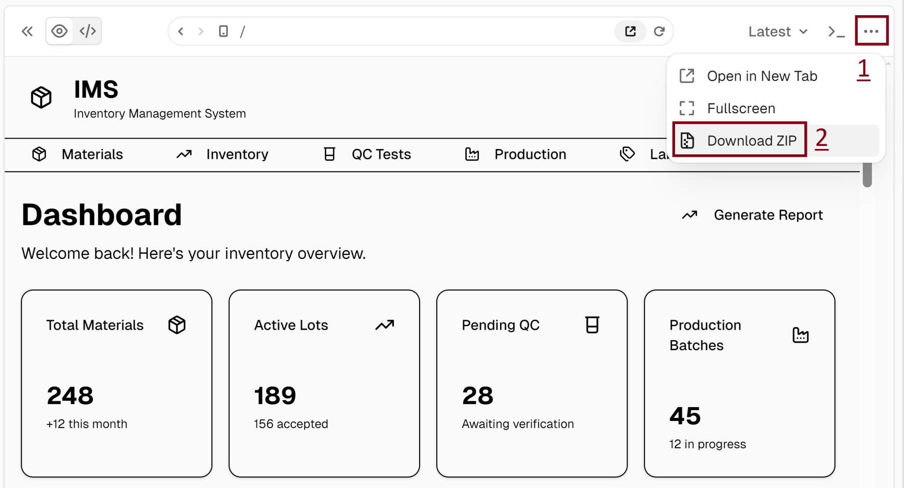
2. Download the Code

Slide 7


Slide 8
1. Add an Image to Phone Frame
https://mockuphone.com/

Slide 9

Thank You & See You Again

